Slide 1


2024
Shopping Cart
System
D-B9-2130-6
FONG CHON HOU

Slide 2
01
Introduction
CONTENT
02
Function Design
03
Project walkthrough
04
Conclusion

Slide 3
01
Introduction

Slide 4

Why did I choose this Shopping Cart System?
Improving the shopping experience:
1
The shopping cart system allows users to easily select and collect products that interest them, helping them browse and purchase more effectively.
Here are some reasons to design a shopping cart system.
Promoting sales:
2
By providing shopping carts and checkout functions, merchants can easily complete online sales. The shopping cart system can also support promotions, coupons, and other marketing strategies to increase sales.
User interaction and management:
3
The system allows users to manage items in their shopping cart, view total amounts, and modify purchase quantities.
Order and Inventory Management:
4
For merchants, the shopping cart system can help track orders and inventory, ensuring efficient management of the product supply chain.

Slide 5
02
Function Design

Slide 6
addToCart(productId): Adds a product to the cart if it doesn't already exist.
updateCartQuantity(productId, quantity): Updates the quantity of a specific product in the cart.
removeCartItem(productId): Removes a specific product from the cart.
clearCart(): Removes all products from the cart.
placeOrder(name, email, phone, address, paymentMethod): Processes the order by saving the customer details and order information to the database, and clearing the cart.
setAlertMessage(type, message): alert message with a specific type (e.g., success or error).
getAlertMessage()
displayCheckoutForm(): Renders the form where users can enter their personal and payment details.
placeOrder(name, email, phone, address, paymentMethod): Processes the order by saving the customer details and order information to the database, and clearing the cart.
Homepage (index.php):
Cart Page (cart.php)
displayProducts(): Renders the list of available products with their details and an "Add to Cart" button for each product.
displayCart(): Retrieves the products added to the cart from the database and displays them with their details, quantities, and total prices.
updateQuantity(productId, quantity): Updates the quantity of a specific product in the cart.
removeProduct(productId): Removes a specific product from the cart.
clearCart(): Removes all products from the cart.
Checkout Page (checkout.php)
Backend Operations (action.php)
Notes:
模板来自于： 第一PPT https://www.1ppt.com/

Slide 7
03
Project walkthrough

Slide 8
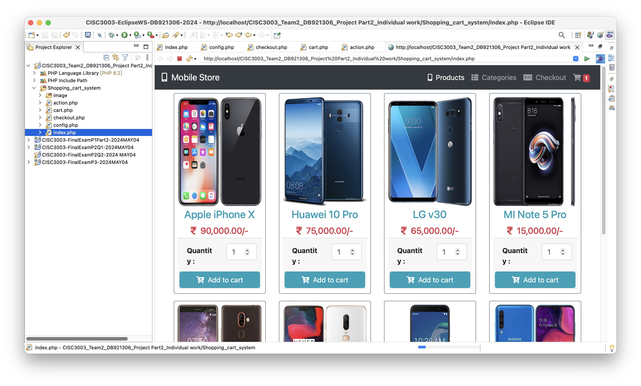
Homepage (index.php):

Slide 9
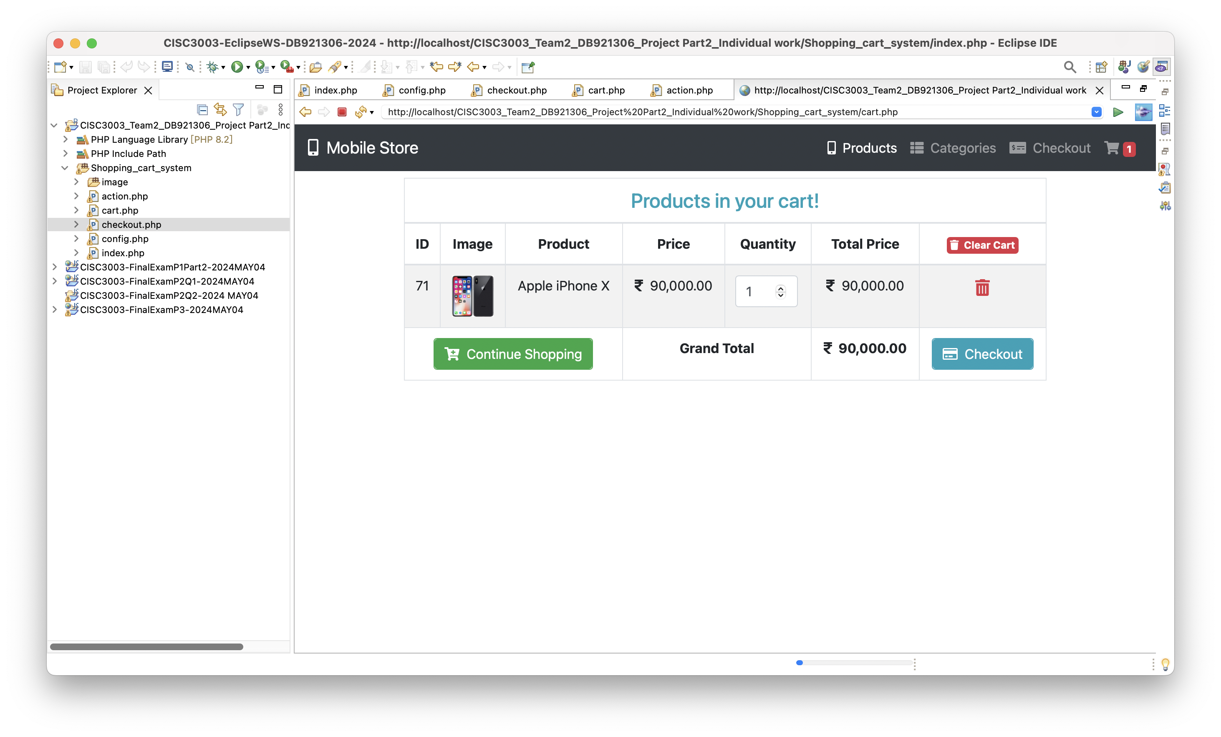
Cart Page (cart.php):

Slide 10
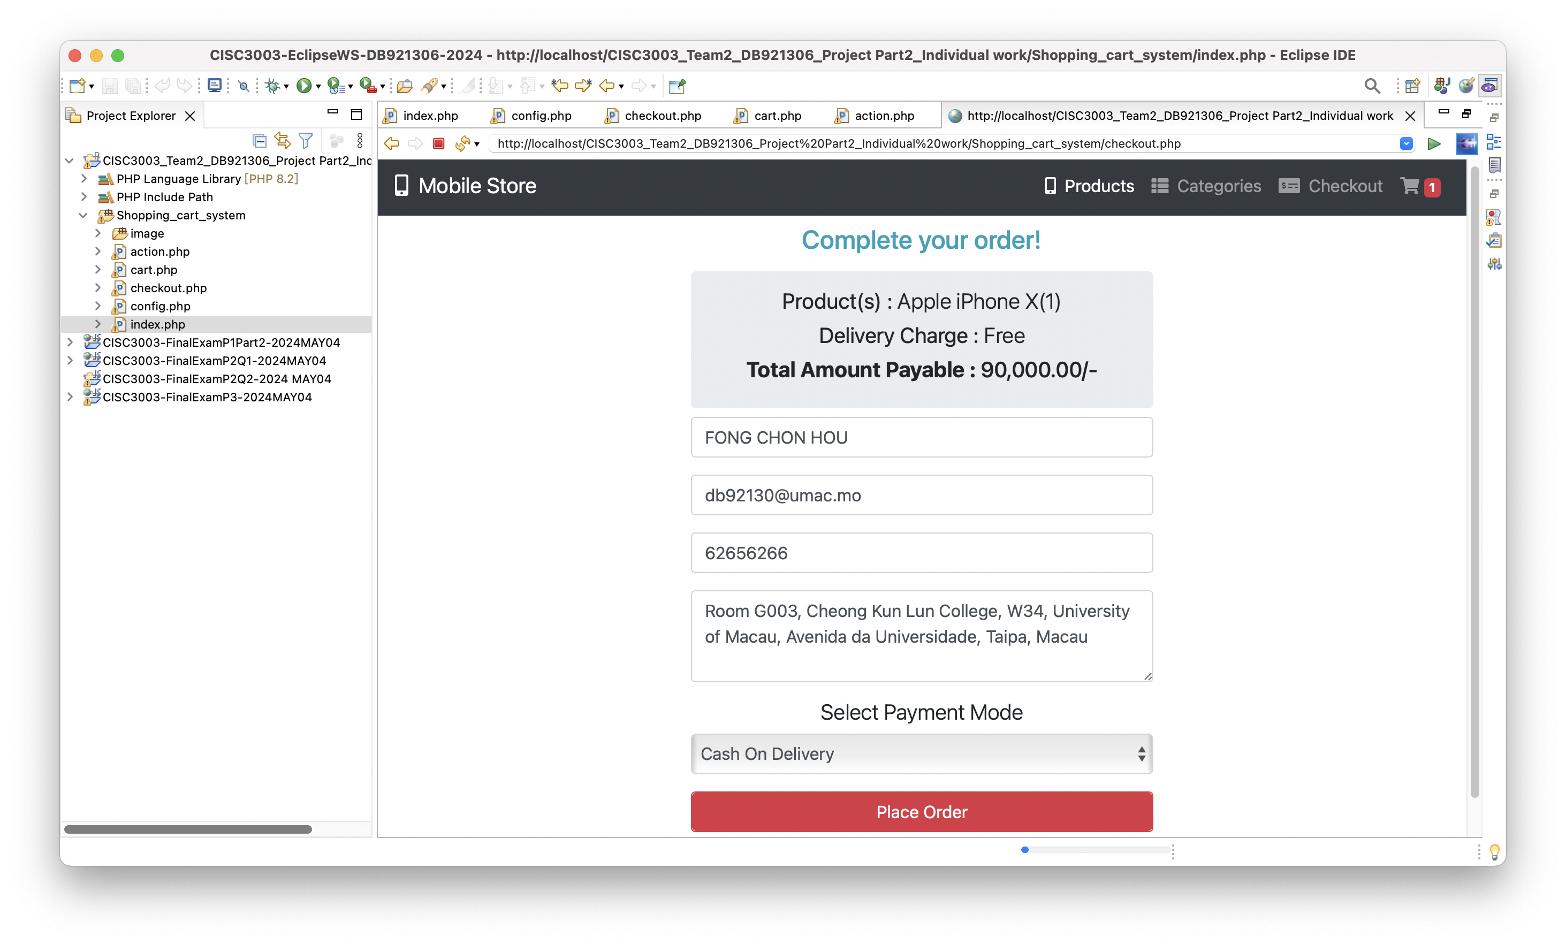
Checkout Page - Fill up the information
(checkout.php)

Slide 11
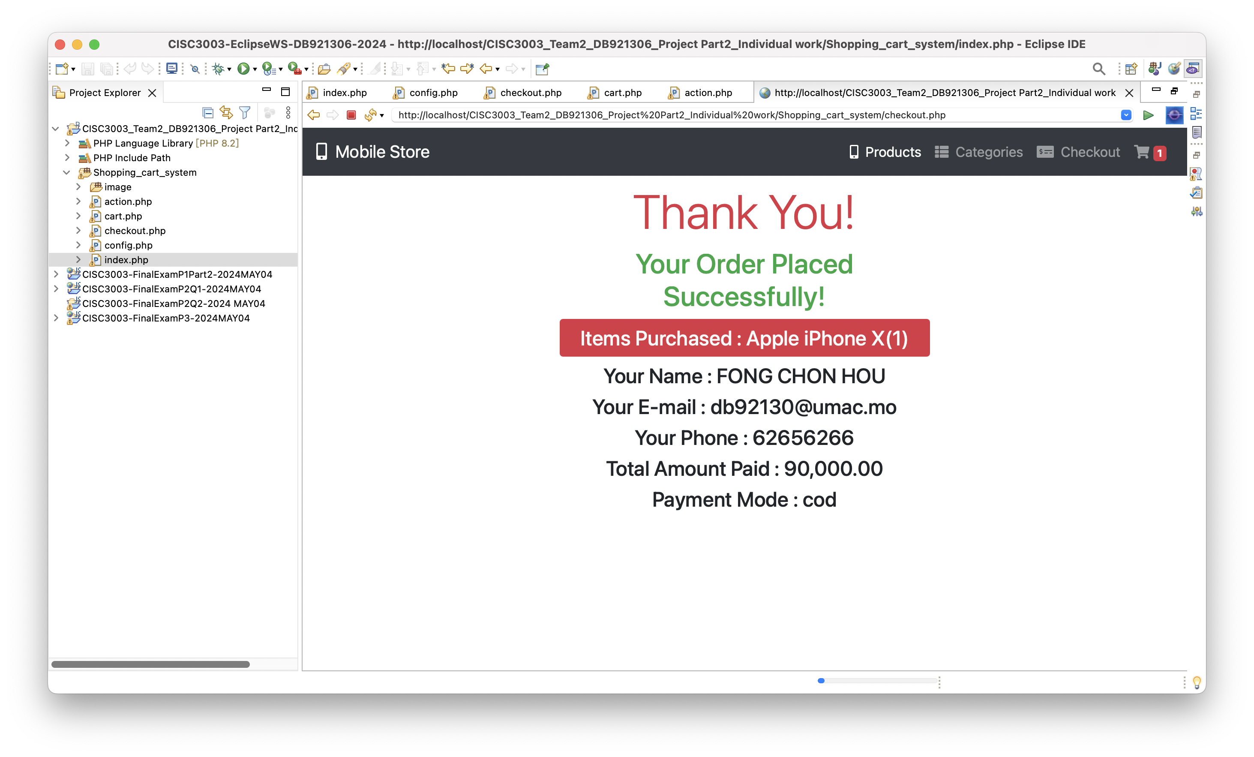
Checkout Page – Show the order result
through Backend Operations (action.php) )

Slide 12
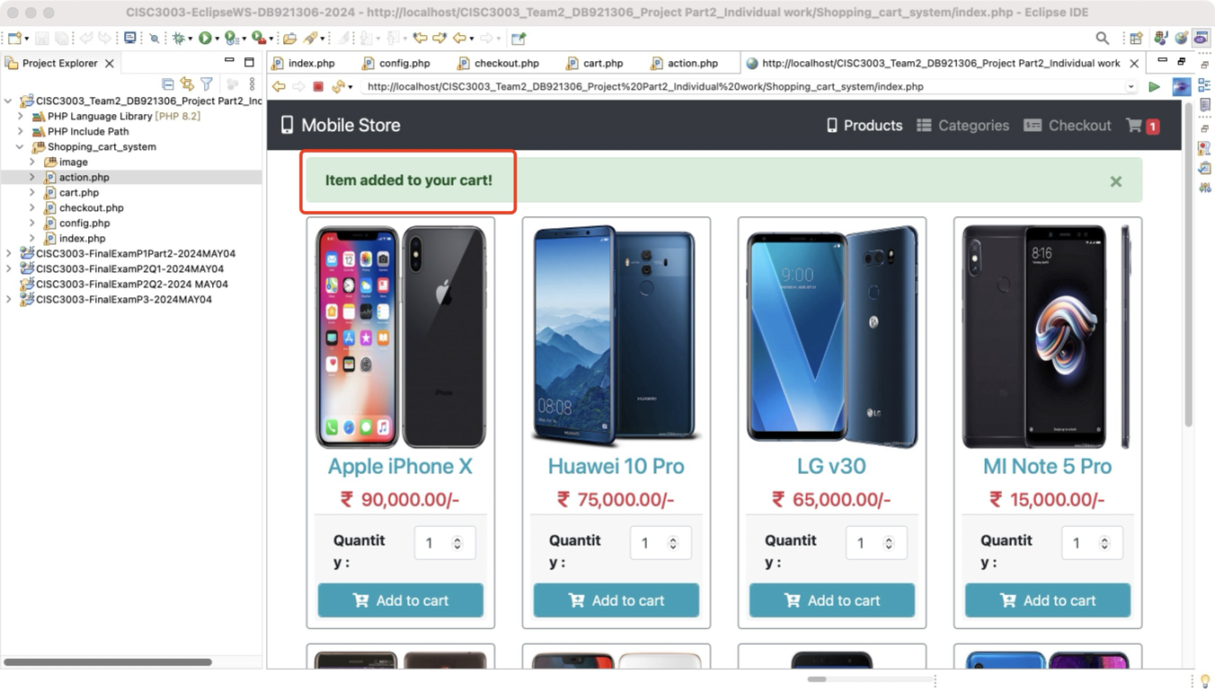
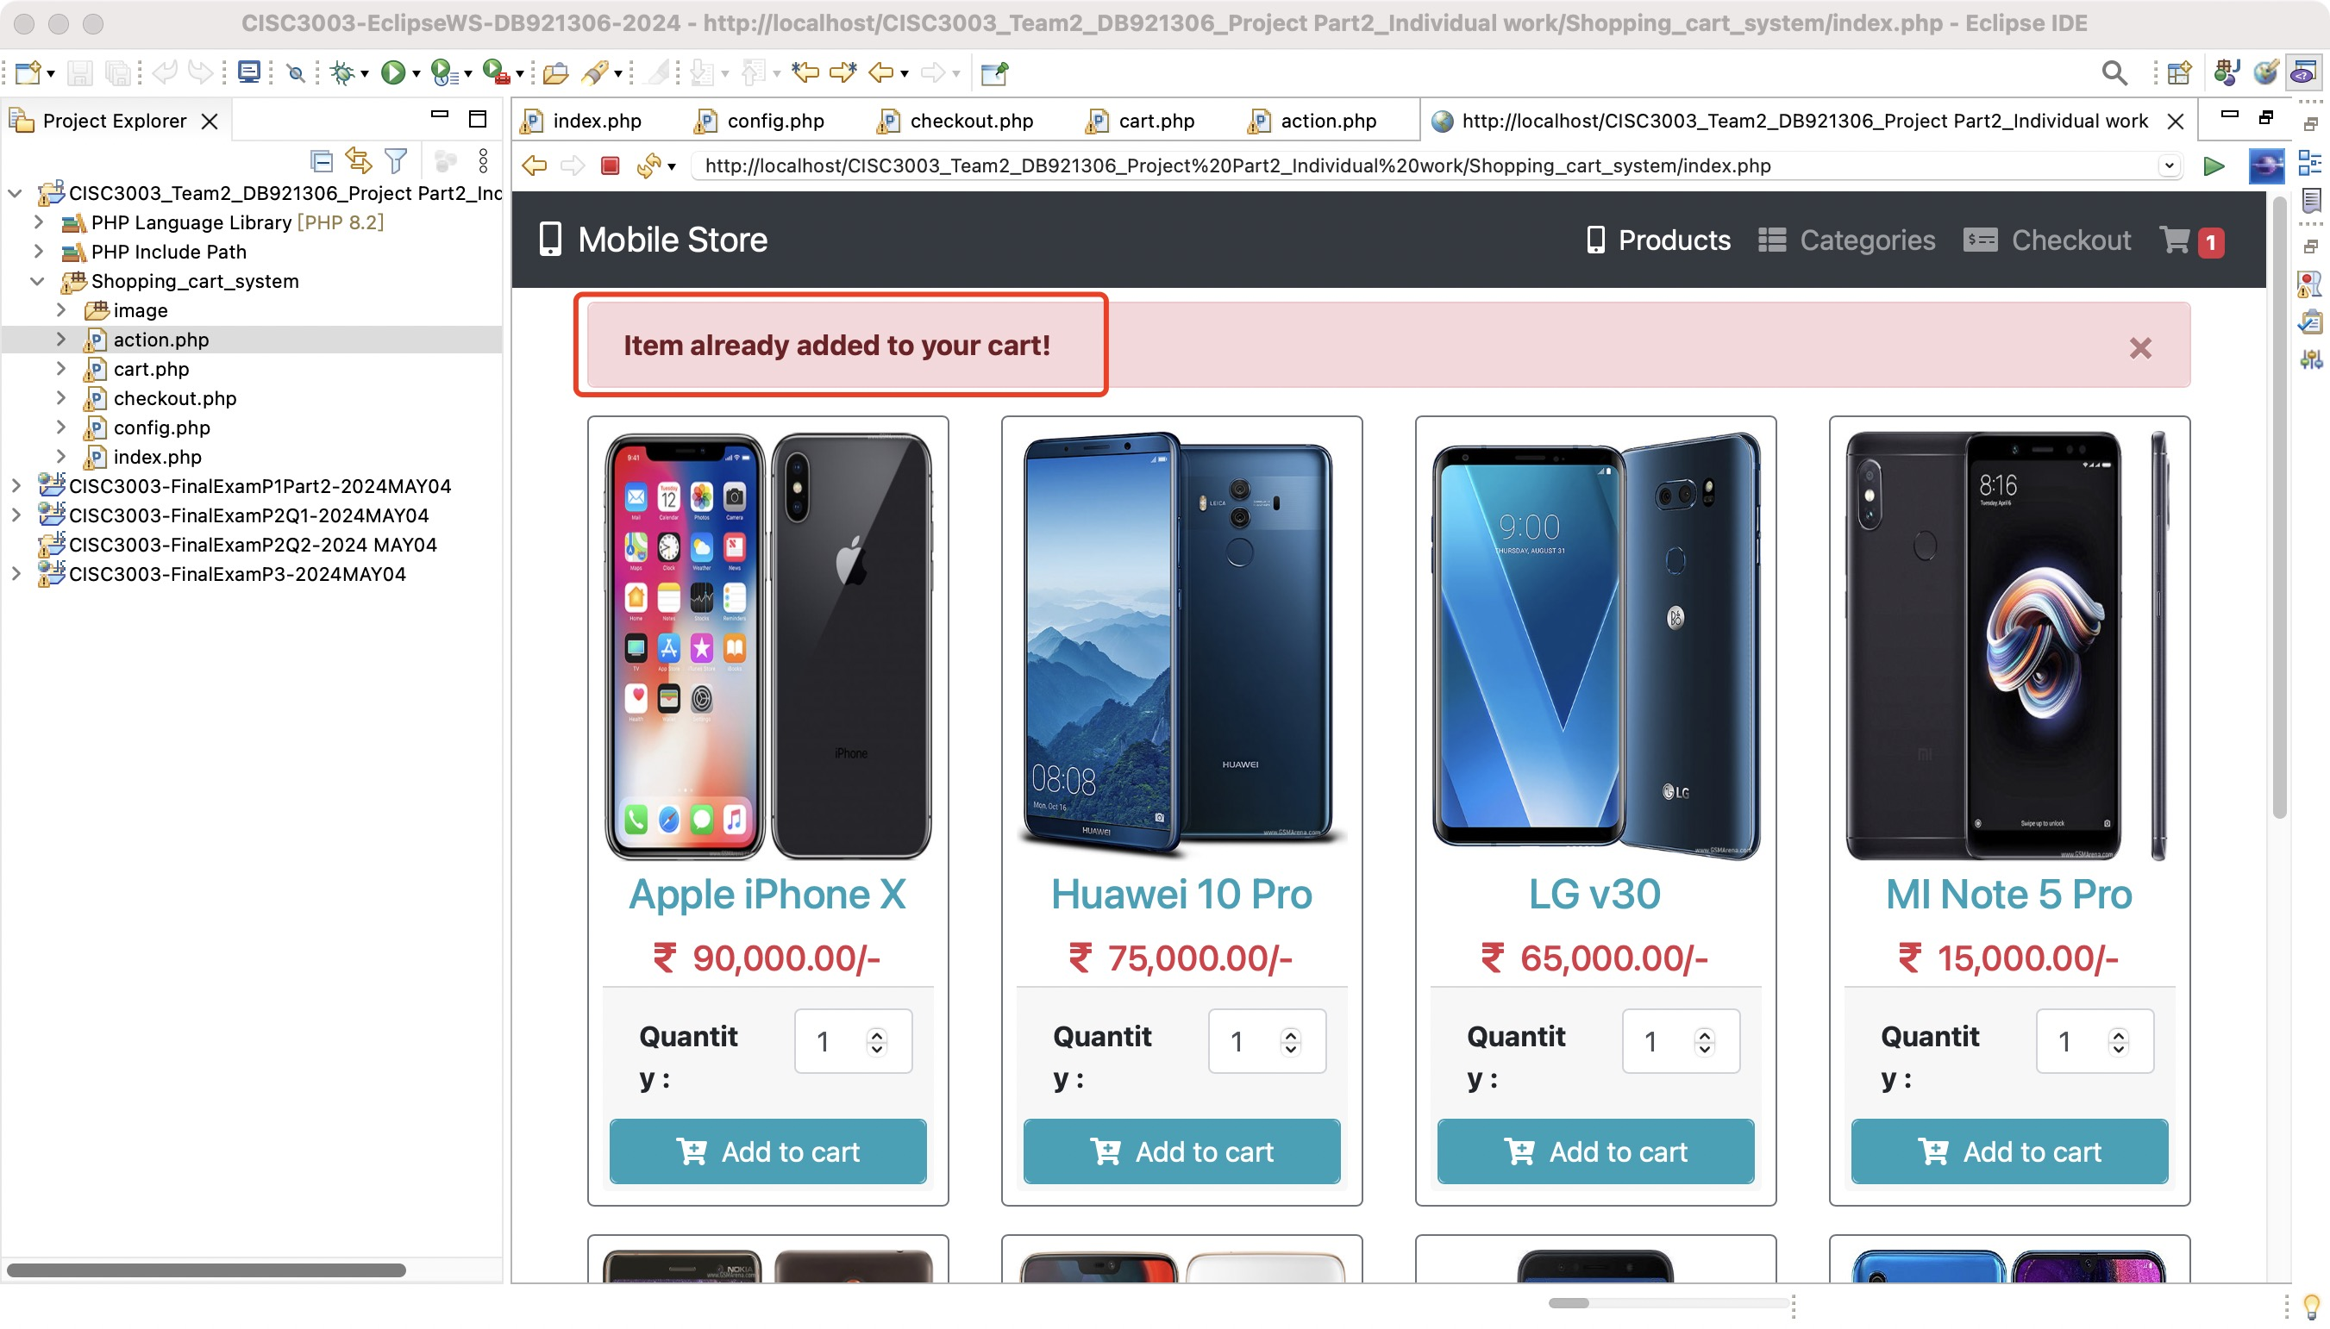
Homepage (index.php) through Backend Operations (action.php)
When the user adds a product to the shopping cart, it checks if the same product already exists in the cart.
If it is a new product, add it to the cart data table and display a successful warning box.
If the product already exists in the shopping cart, an error warning box will be displayed.

Slide 13
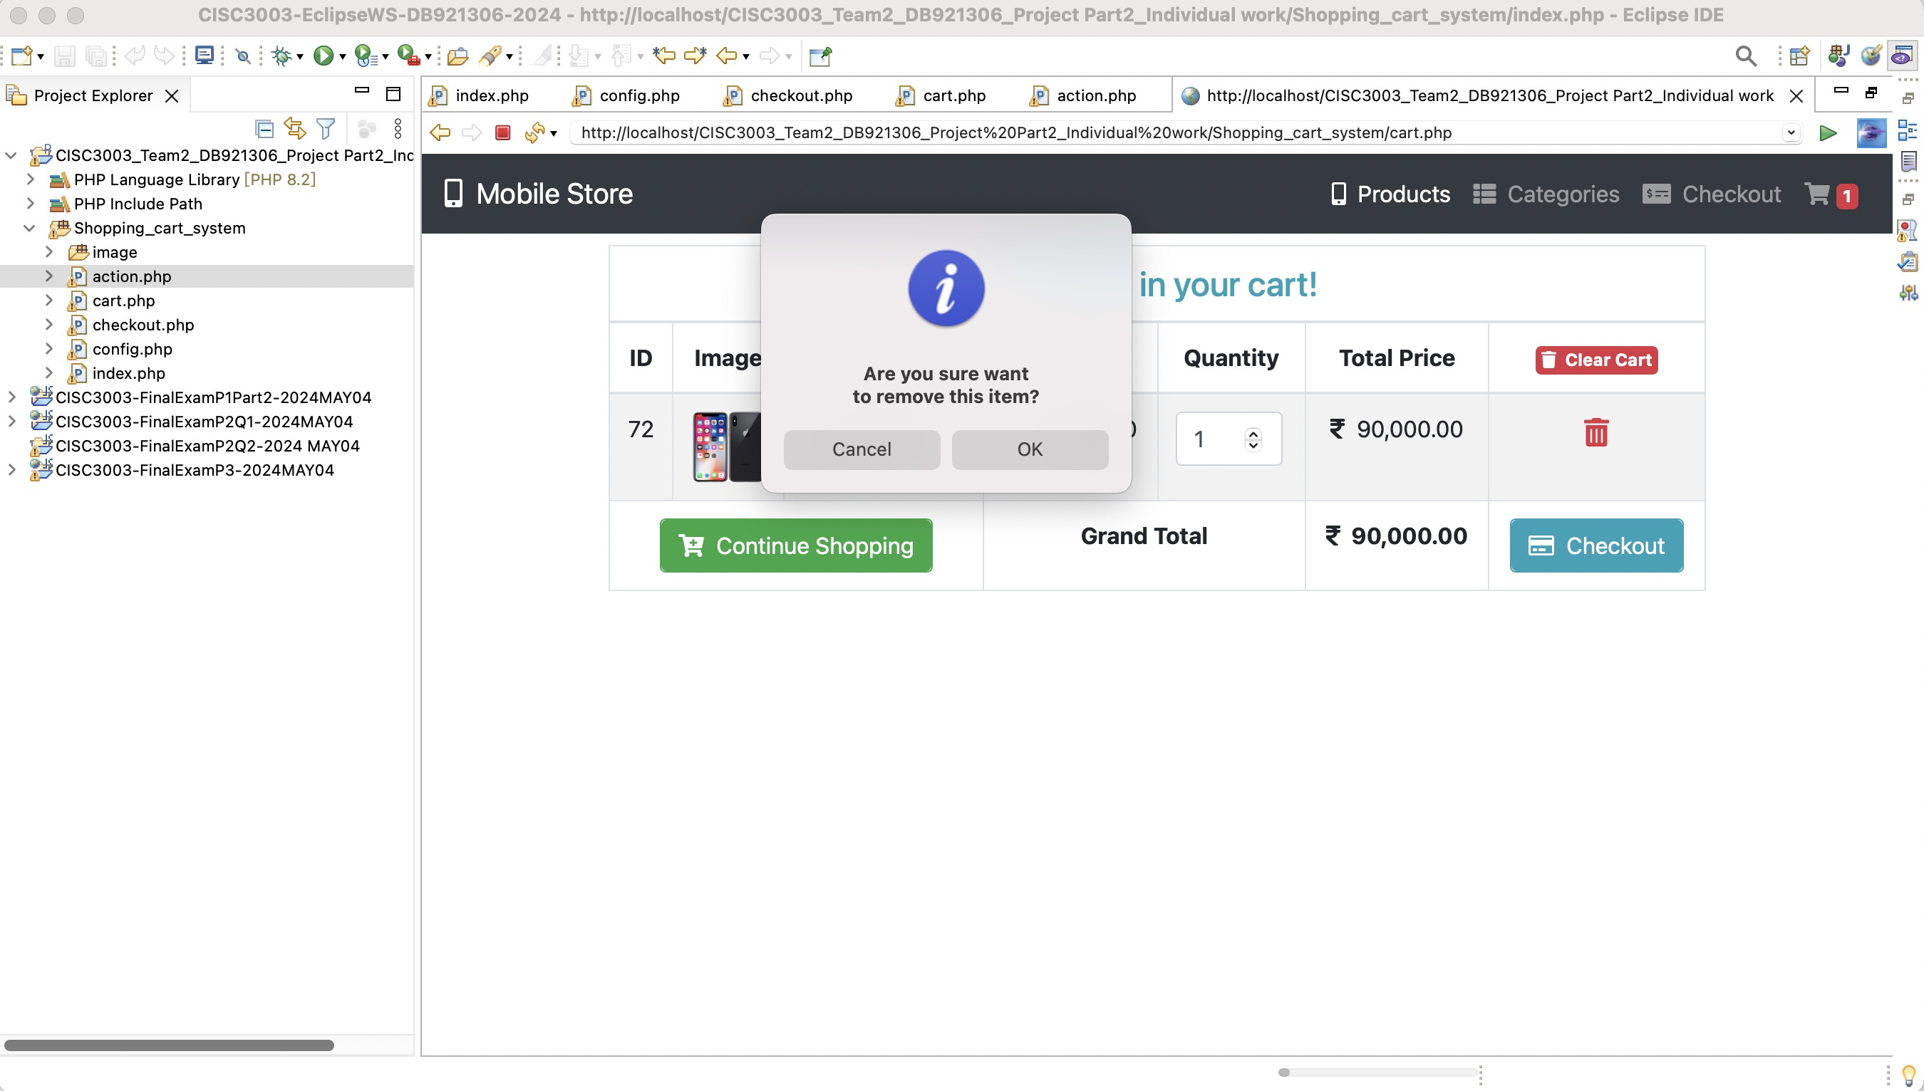
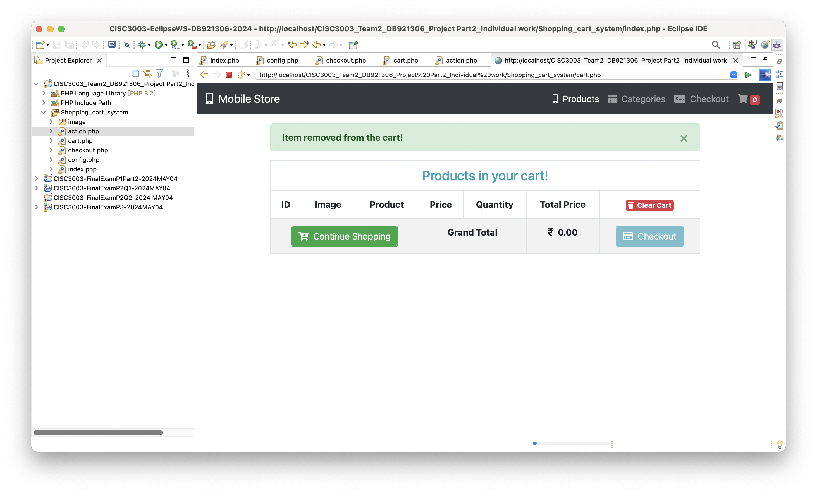
Cart Page (cart.php)
through Backend Operations (action.php)
addToCart(productId): Adds a product to the cart if it doesn't already exist.
removeCartItem(productId): Removes a specific product from the cart.
clearCart(): Removes all products from the cart.

Slide 14
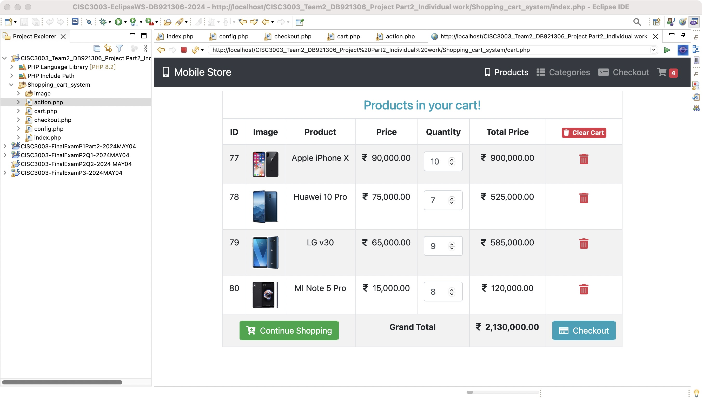
Cart Page (cart.php)
through Backend Operations (action.php)
updateCartQuantity(productId, quantity): Updates the quantity of a specific product in the cart.

Slide 15
Responsive Web Design

Slide 16
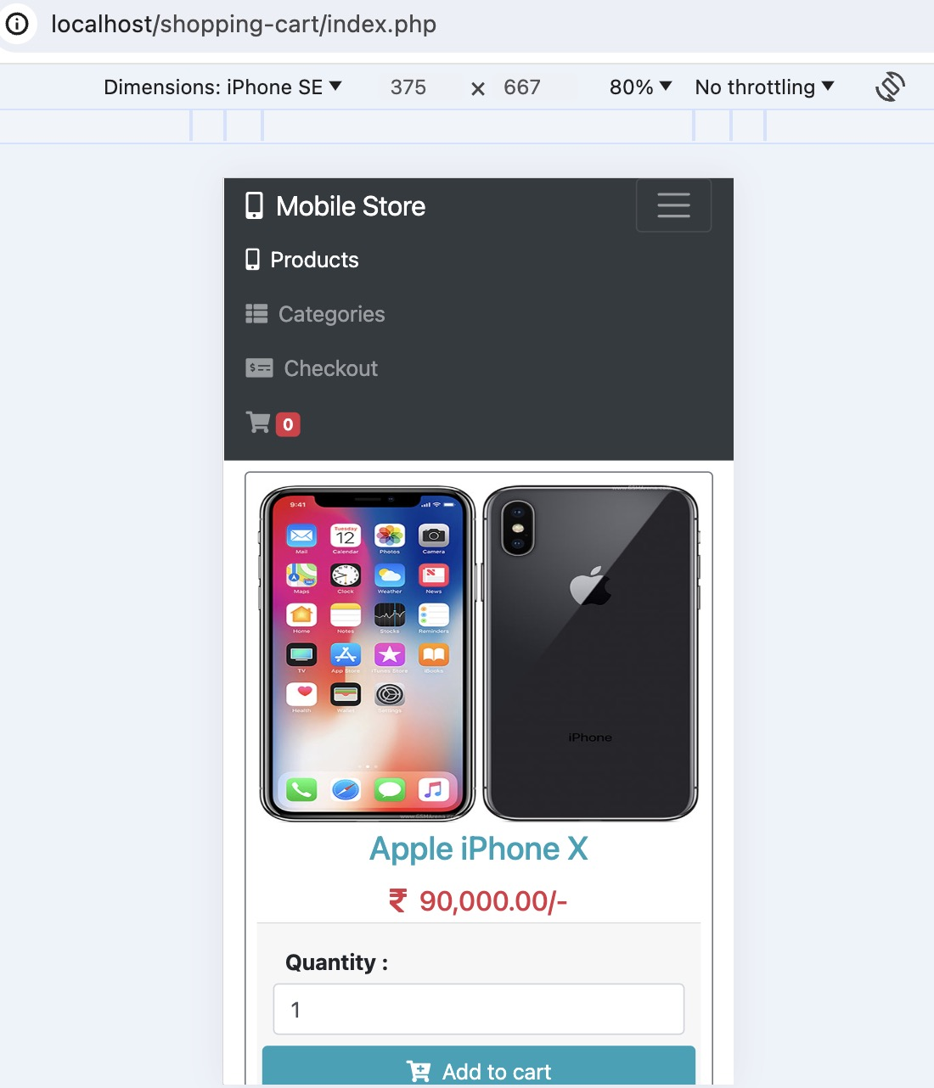
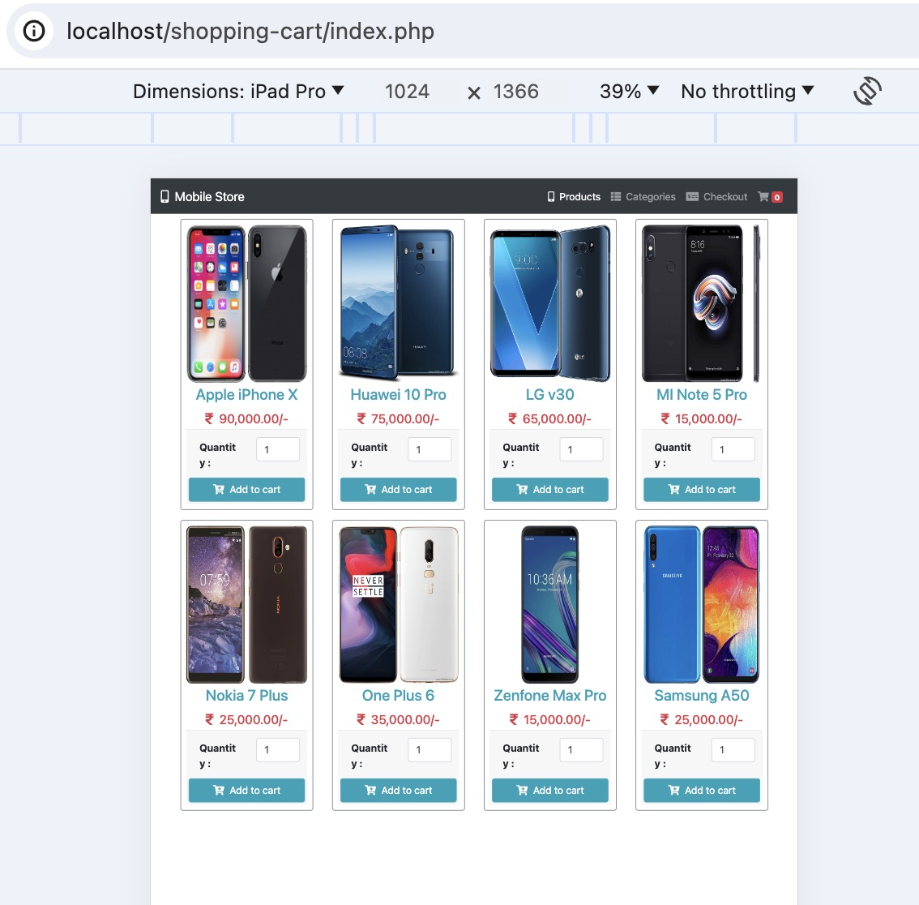
Phone
Tablet

Slide 17
04
Conclusion

Slide 18
Conclusion
User-Friendly Interface: The shopping cart system offers an intuitive interface, allowing users to easily browse, add, and purchase products.
Technology Stack: The system utilizes a combination of HTML, CSS, JavaScript, jQuery, and PHP to create a robust e-commerce application.
File Structure: The files are well-organized, with separate sections for the homepage, cart, checkout, and backend operations, ensuring clarity and maintainability.
Homepage: Users can view products with details and add them to the cart directly from the homepage, enhancing accessibility and convenience.
Cart Management: The cart page allows users to manage product quantities and remove items, providing flexibility and control over the shopping experience.
Checkout Process: The checkout page collects user information and seamlessly processes orders, streamlining the purchasing process.
Backend Operations: A dedicated script handles various cart operations, performs database queries, and stores user data securely, ensuring efficient functionality.
Efficiency and User Experience: Overall, the shopping cart system is efficient and delivers a seamless user experience, enhancing the online shopping journey.

Slide 19
2024
THANKS
DO YOU HAVE ANY QUESTIONS
D-B9-2130-6
FONG CHON HOU

